Slide 1




2.0 Managing a Project in ProjectTeam for the National Park Service

Slide 2



Today’s Trainers
John Bunch
ProjectTeam Sr. Business Consultant
NPS Configuration Lead
Loretta Maine
ProjectTeam Business Consultant
NPS National Systems Administrator

Slide 3





Housekeeping
Session is being Recorded
Slides will be made Available
NPS Training Webpage: projectteam.com/NPS
Enter Questions in the Q&A

Slide 4

Agenda
  Access Your New Project
  Project Directory
  Drawings and Drawing Packages
  Specifications
  Submittals and Submittal Packages
  Questions?
  Break
  RFIs
  Meetings
  Daily Reports
  Punch Lists
  Questions?

Slide 5
Log In – NPS Environment
  https://gov.projectteam.com
Notes:
You will access ProjectTeam for all new NPS projects by Logging in to gov.projectteam.com.
Bookmark the page.

Slide 6
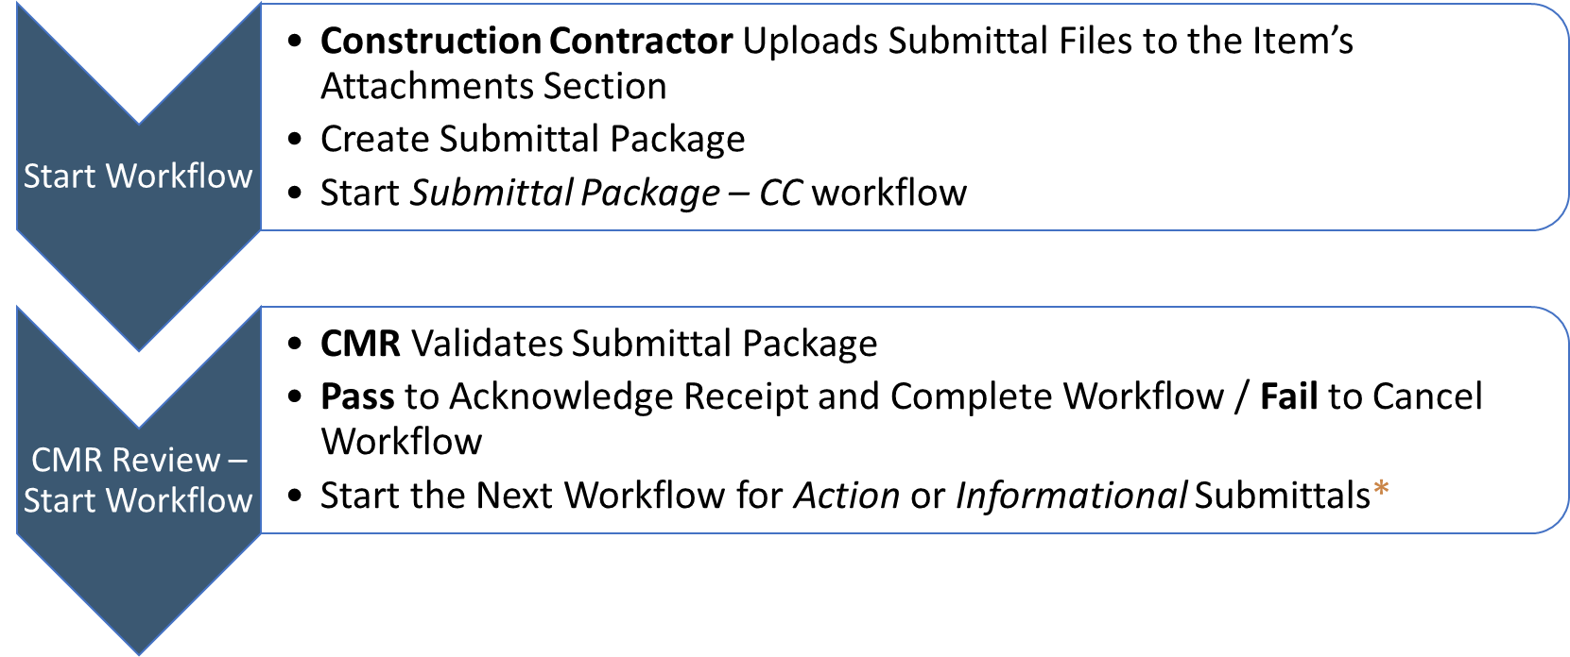
Submittal Package – CC Workflow
Notes:
You will access ProjectTeam for all new NPS projects by Logging in to gov.projectteam.com.
Bookmark the page.

Slide 7
Submittal – Action – A/E Input
Start Workflow
A/E Action
COR Review
CMR Reviews Submittal Package
A/E Reviews each Submittal Item Details and Files
Select A/E Action, Enter Action Notes, Upload Marked Up Files, Complete Package Fields
Pass to send to the COR/ Cancel to remove Submittal from workflow
COR Reviews each Submittal Item’s Details and Attachments
Contractor Acknowledgement
Construction Contractor Validates Package and Items are properly reviewed
Select NPS Action, Enter Action Notes, and Close Items that don’t need to be resubmitted.
Upload Marked Up Files, Complete Package Fields
Pass to send to Construction Contractor / Fail to return to A/E for Additional Information
Pass to Acknowledge Receipt / Fail to return to COR or A/E for Additional Information
Create Revisions, as needed
Start the Submittal Package – Action – with A/E Review Workflow
COR also has access to start this workflow.
Notes:
You will access ProjectTeam for all new NPS projects by Logging in to gov.projectteam.com.
Bookmark the page.

Slide 8
Submittal – Action – no A/E Review
Start Workflow
COR Review
Contractor Acknowledgement
CMR Reviews Submittal Package
COR Reviews each Submittal Item’s Details and Attachments
Start the Submittal Package – Action – no A/E Review Workflow
Construction Contractor Validates Package and Items are properly reviewed
Select NPS Action, Enter Action Notes, and Close Items that don’t need to be resubmitted.
Upload Marked Up Files, Complete Package Fields
Pass to send to Construction Contractor / Cancel to remove Submittal from workflow
Pass to Acknowledge Receipt / Fail to return to COR for Additional Information
Create Revisions, as needed
Notes:
You will access ProjectTeam for all new NPS projects by Logging in to gov.projectteam.com.
Bookmark the page.

Slide 9
Submittal – Information Only
Start Workflow
COR Review
Contractor Acknowledgement
CMR Reviews Submittal Package
COR Reviews each Submittal Item’s Details and Attachments
Start the Submittal Package – Information ONLY Workflow
Construction Contractor Validates Package and Items are properly reviewed
Select NPS Action, Enter Action Notes, and Close Items that don’t need to be resubmitted.
Upload Marked Up Files, Complete Package Fields
Pass to send to Construction Contractor / Cancel to remove Submittal from workflow
Pass to Acknowledge Receipt / Fail to return to COR for Additional Information
Create Revisions, as needed
Notes:
You will access ProjectTeam for all new NPS projects by Logging in to gov.projectteam.com.
Bookmark the page.

Slide 10
Share Rule: Share to All
Related Forms:
  Construction Contractor Daily,
  Drawing Packages,
  Drawings,
  Project Schedules,
  Specification Packages,
  Specifications
Shared When COR:
  Creates, Shares, or Gets Shared
Shared To:
  Architect / Engineer,
  Construction Contractor PM & Superintendent,
  Construction Manager Representative,
  NPS - PM, PS, COR, CO, CS,
  NPS - DSC Management,
  NPS - Region/Park Staff
Notes:
You will access ProjectTeam for all new NPS projects by Logging in to gov.projectteam.com.
Bookmark the page.

Slide 11
Workflow Sharing - RFIs
Step 1 - CMR Review
  Construction Manager Representative
  Construction Contractor - Project Manager
  Construction Contractor - Superintendent
  NPS - Project Manager/Project Specialist/COR
Step 2 - COR Review
  NPS - Contracting Officer/Contracting Specialist
  NPS - DSC Management
  NPS - Region/Park Staff
Step 3 - Release to Construction Contractor
  Architect/Engineer
Notes:
You will access ProjectTeam for all new NPS projects by Logging in to gov.projectteam.com.
Bookmark the page.

Slide 12
Workflow Sharing – Submittal Package
Step 1 - CMR to Validate Submittal Package and Start Workflow
  Construction Manager Representative
  Construction Contractor - Project Manager
  Construction Contractor - Superintendent
  NPS - Contracting Officer/Contracting Specialist
  NPS - Project Manager/Project Specialist/COR
Step 2 - COR Review
  Architect / Engineer
  NPS - DSC Management
Step 3 - Release to Construction Contractor
  NPS - Region/Park Staff
Notes:
You will access ProjectTeam for all new NPS projects by Logging in to gov.projectteam.com.
Bookmark the page.

Slide 13
Share Rule: Inspections
Related Form:
  Field Report
Shared When COR:
  Creates, Shares, or Gets Shared
Shared To:
  Architect / Engineer,
  NPS – PM, PS, COR, CO, CS,
  NPS - DSC Management,
  NPS - Region/Park Staff
Notes:
You will access ProjectTeam for all new NPS projects by Logging in to gov.projectteam.com.
Bookmark the page.

Slide 14
RFI – Workflow
Start Workflow
CMR Review
COR Review
Construction Contractor Creates RFI
CMR Reviews RFI
COR Reviews and Enters Response, Responded By, and Response Date
Contractor Acknowledgement
Construction Contractor Reviews RFI Response
Pass to Send to Contractor / Fail to Return to CMR
Start RFI – Workflow
Pass to Send to COR / Cancel to Remove RFI from Workflow
Pass to Acknowledge Receipt and Complete Workflow / Fail to Return to COR or COR for Additional Information
Start Architect/Engineer Workflow for RFIs, if A/E input is needed*
Start Architect/Engineer Workflow for RFIs, if A/E input is needed*
Notes:
You will access ProjectTeam for all new NPS projects by Logging in to gov.projectteam.com.
Bookmark the page.

Slide 15
RFI: Architect/Engineer Workflow
Start Workflow
A/E Input
Proceed with Review
CMR or COR Start Architect/Engineer Workflow to Send to A/E for Input.
Architect/Engineer Review and Enter Input to COR Response Field and Upload Supporting Files.
COR Validates A/E input
Pass to Send to COR / Cancel to Remove RFI from Workflow
Pass to Complete and proceed with Step 2 of the RFI - Workflow
Fail to Return to A/E for Additional Information
Notes:
You will access ProjectTeam for all new NPS projects by Logging in to gov.projectteam.com.
Bookmark the page.

Slide 16
Important Links
Resources: www.projectteam.com/nps
Help Email Address: support@projectteam.com
Login: gov.projectteam.com
Recorded Webinar
Slide Deck
Quick Reference Guides
Training Videos
Opens a Support Ticket

